Slide 1
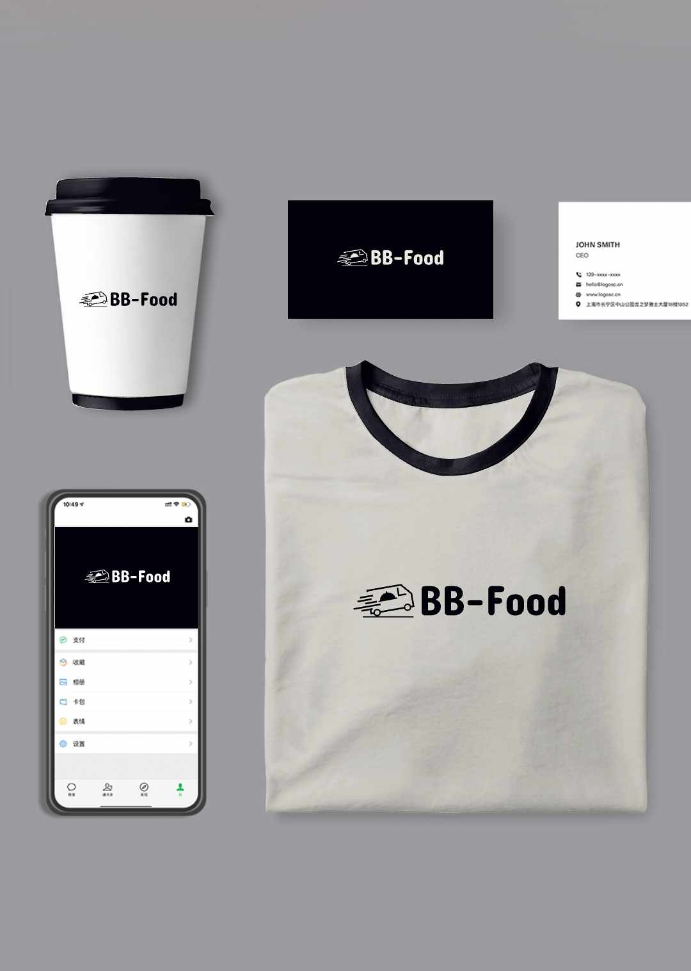
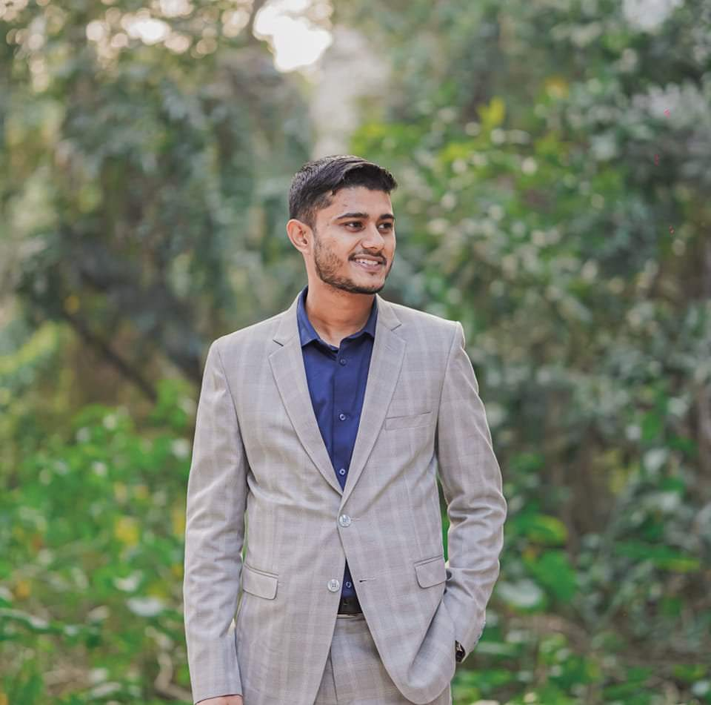
"BB-Food" Web and App based E-commerce Platform.
Presented to MOHIUDDIN HASAN
LECTURER, DEPT. OF CSE
Presented by Team: 'Binary Beasts'

Slide 2
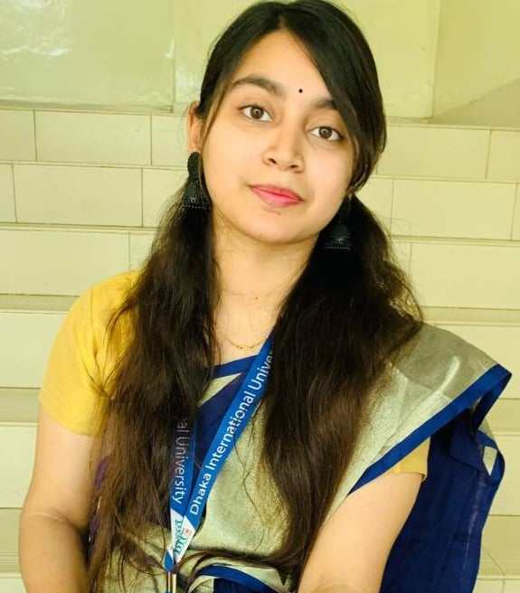
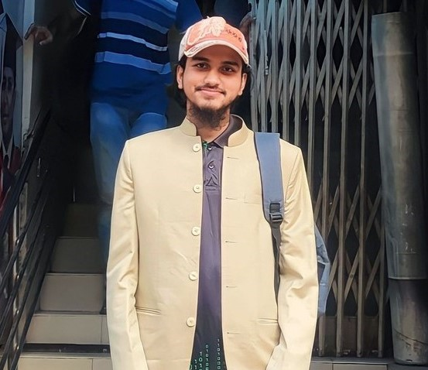
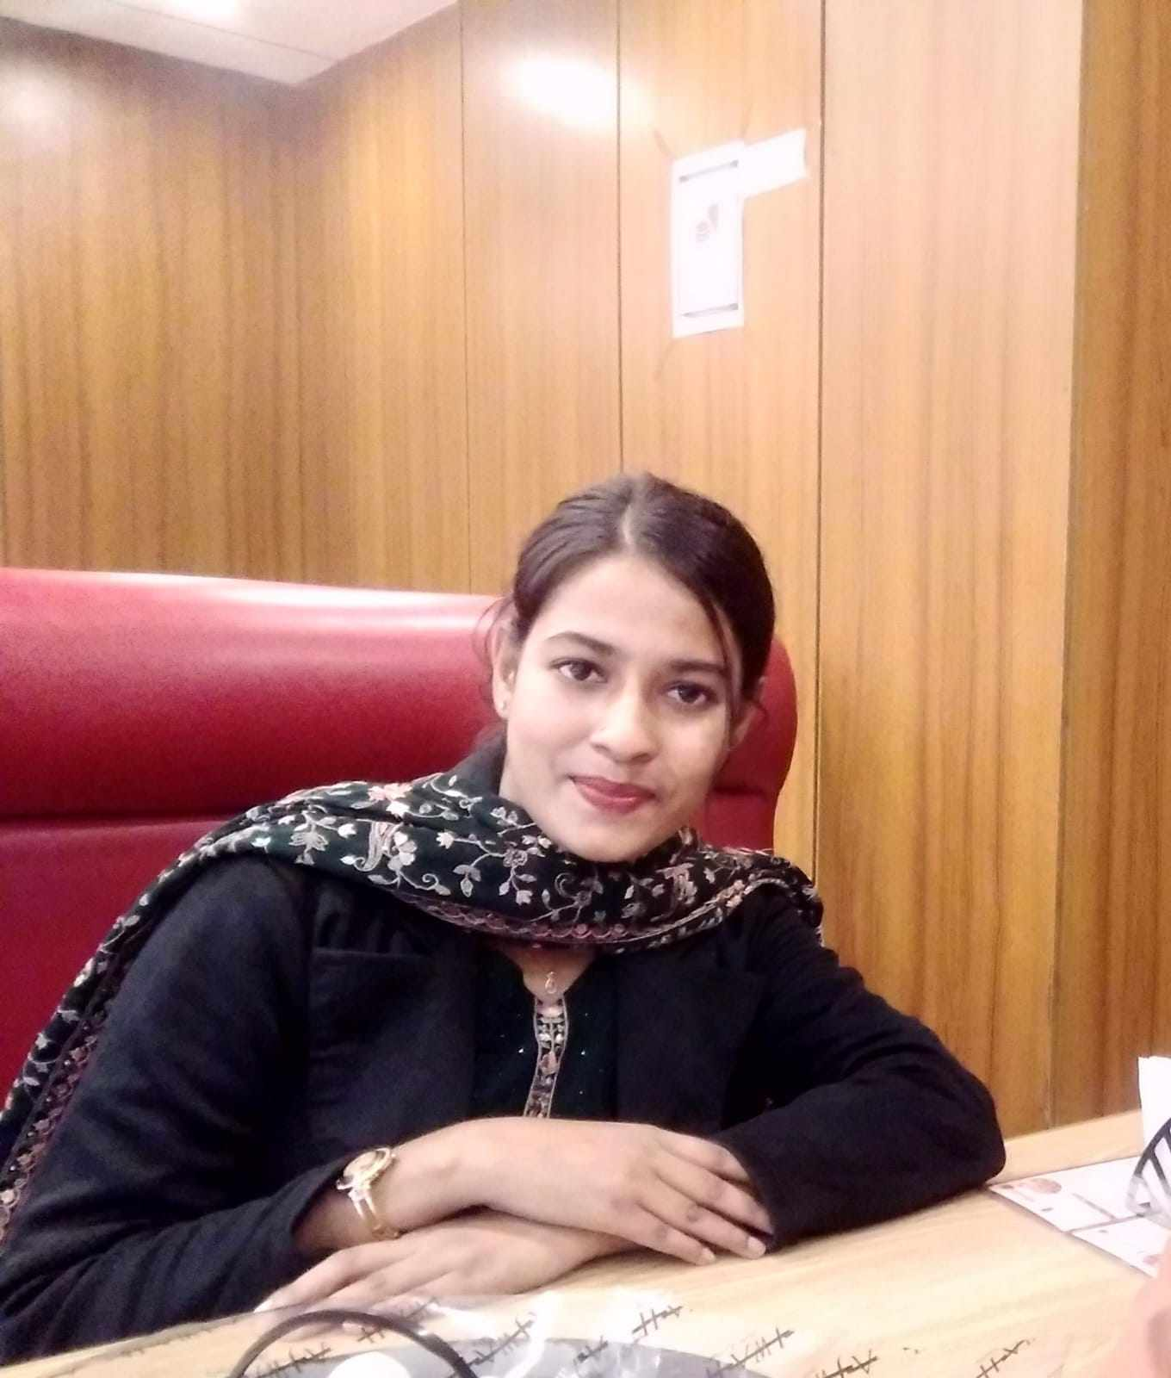
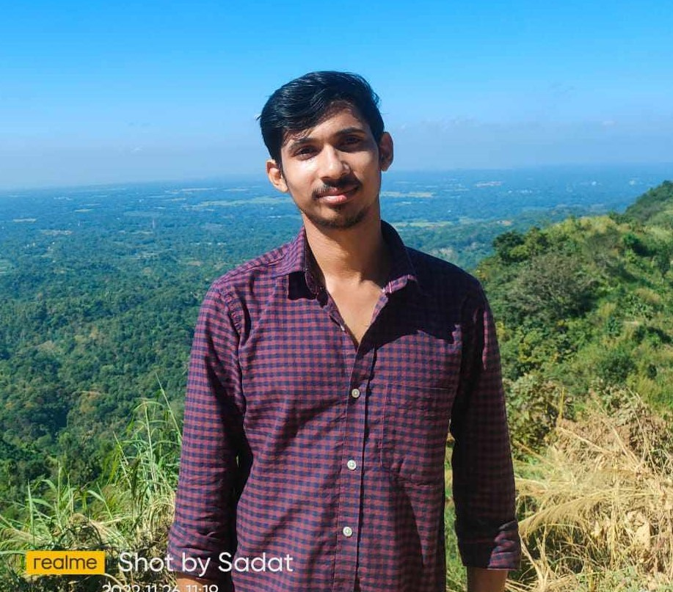
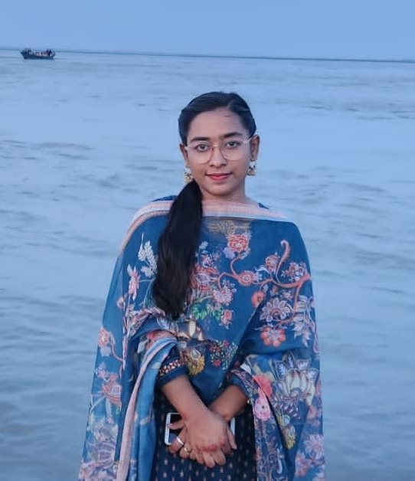
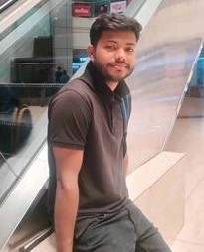
Meet Our Team : 'Binary Beasts'
SADIA AKTER ORPA
ABU SALEH MD NAZMUS SADAT
Roll:28
Roll:35
MD. JAHID AHAMMED SUJAN
ZANNATUL FERDOUSH JUI
Roll:56
Roll:07
MRS TAHAT TANIA
MD. NAHIDUL HASAN
Roll:33
Roll:36

Slide 3
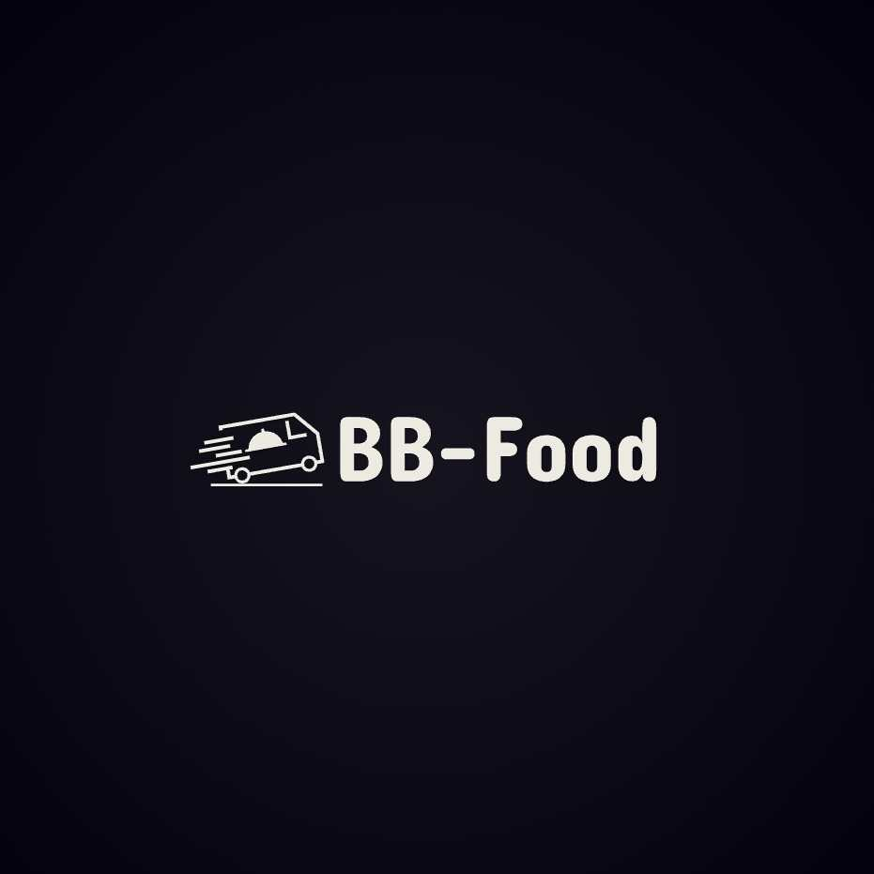
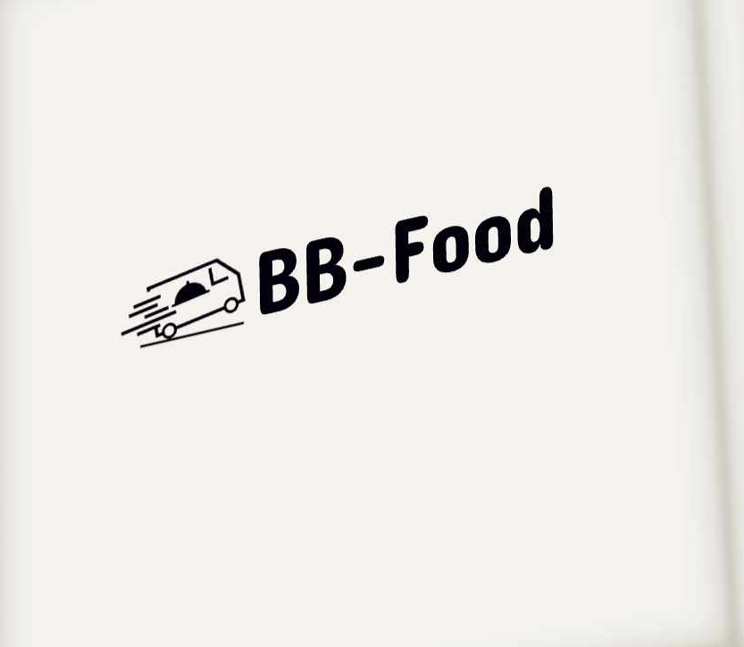
INDEX:
Introduction
CONTEXT
Our system Process
Summary
Features
Presentation Title

Slide 4
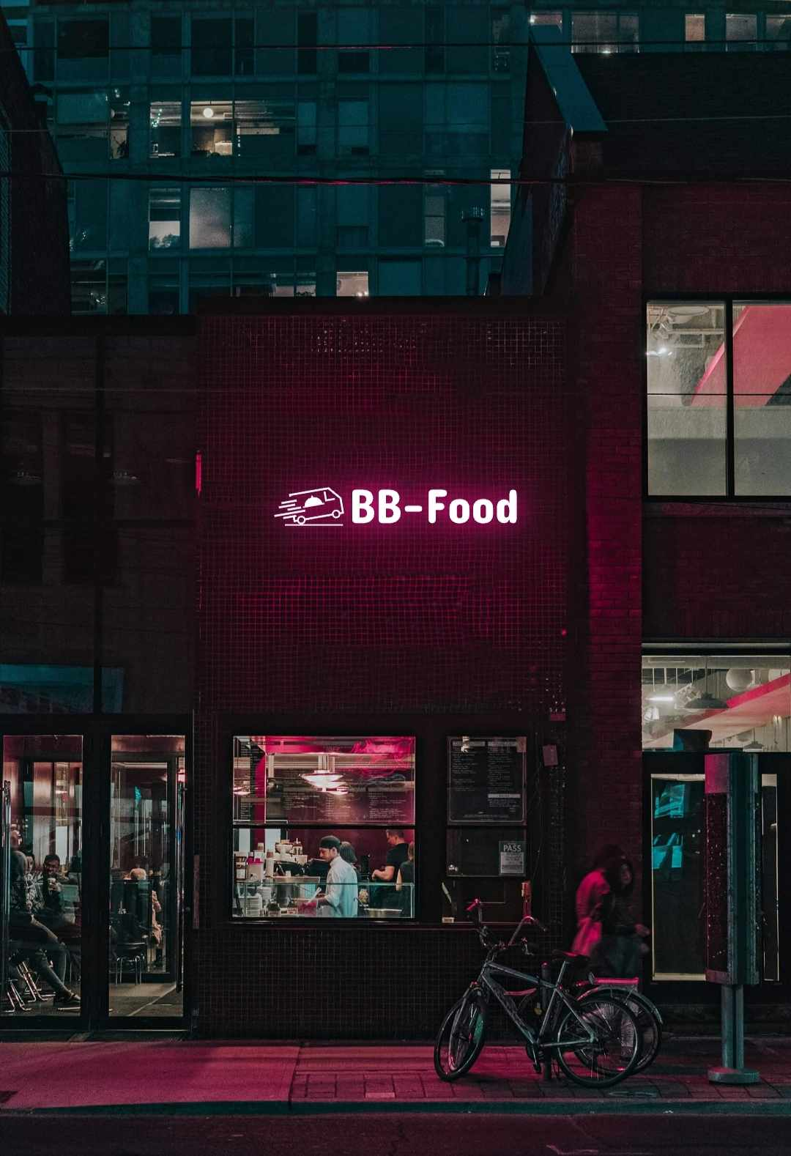
Introduction:
Team "Binary Beasts" designed and implemented a web application named "BB-Food." This application enables users to buy or order food and register their information for booking.

Slide 5
PROJECT CONTEXT:
'BB-Food' E-commerce Platform responds to the increasing demand for convenient food shopping, aiming to provide users with a seamless and engaging experience. Leveraging modern web technologies, the platform facilitates the selection, carting, and purchase of food items, positioning itself as a comprehensive solution for food enthusiasts.

Slide 6
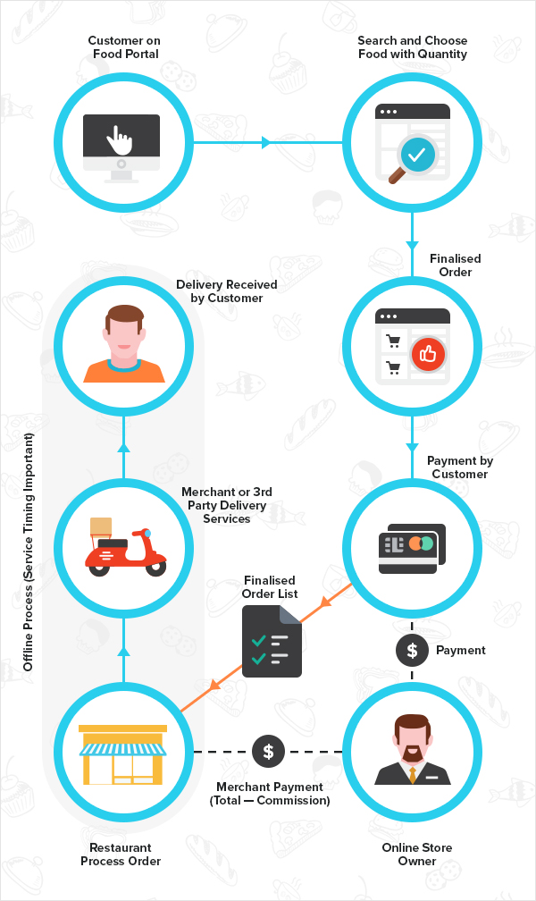
Website
Our system Process

Slide 7
★FEATURES
User Registration And Authentication
Database Management
Product Catalog
Backend Functionality
Shopping Cart and Dynamic Selection
Dynamic Website with JavaScript
Responsive Design
Checkout Process

Slide 8
TACTICAL TOOLS
The following tools and technologies were employed to develop the BB-Food web application:
HTML and CSS for structuring and styling the web pages.
Bootstrap for responsive layout and styling components.
JavaScript for dynamic and interactive elements, creating a seamless browsing and shopping experience.
JQuery for interactive and dynamic elements.
Tailwind is a utility-first CSS framework for rapidly building modern websites without ever leaving your HTML.
DaisyUI provides a collection of pre-designed components that can be easily customized and integrated into any project using Tailwind CSS.
API integration is the connection between two or more applications, via their APIs, that lets those systems exchange data.
React & vite is a build tool that aims to provide a faster and leaner development experience for modern web projects.

Slide 9
CHALLENGES & SOLUTION
1. Interface Enhancement
2. Security Measures
3. Communication Between Components
4. Database Optimization

Slide 10
FUTURE ENHANCEMENTS
Enhanced User Experience
Integration with External APIs
User Reviews & Rating
Online Ordering & Delivery

Slide 11
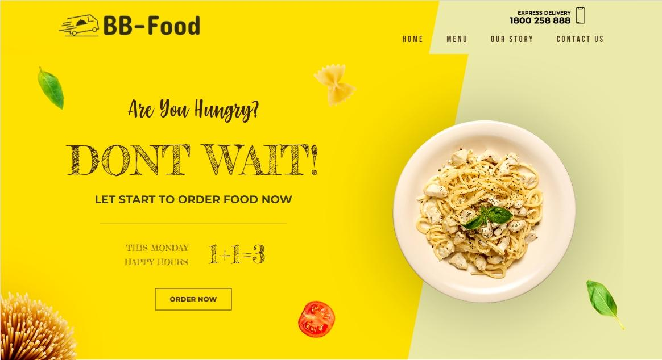
WEB Home page
BB-FOOD

Slide 12
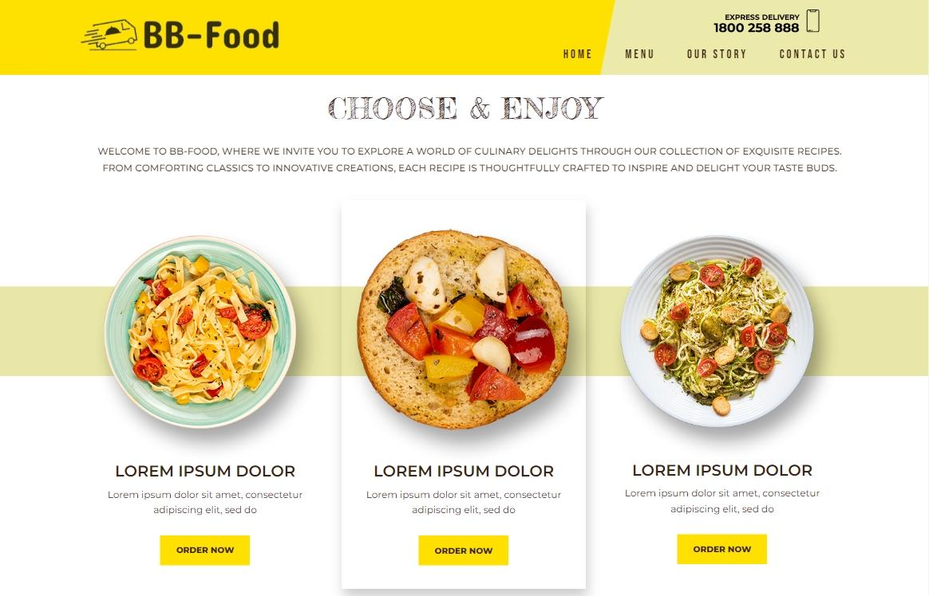
MENU
BB-FOOD

Slide 13
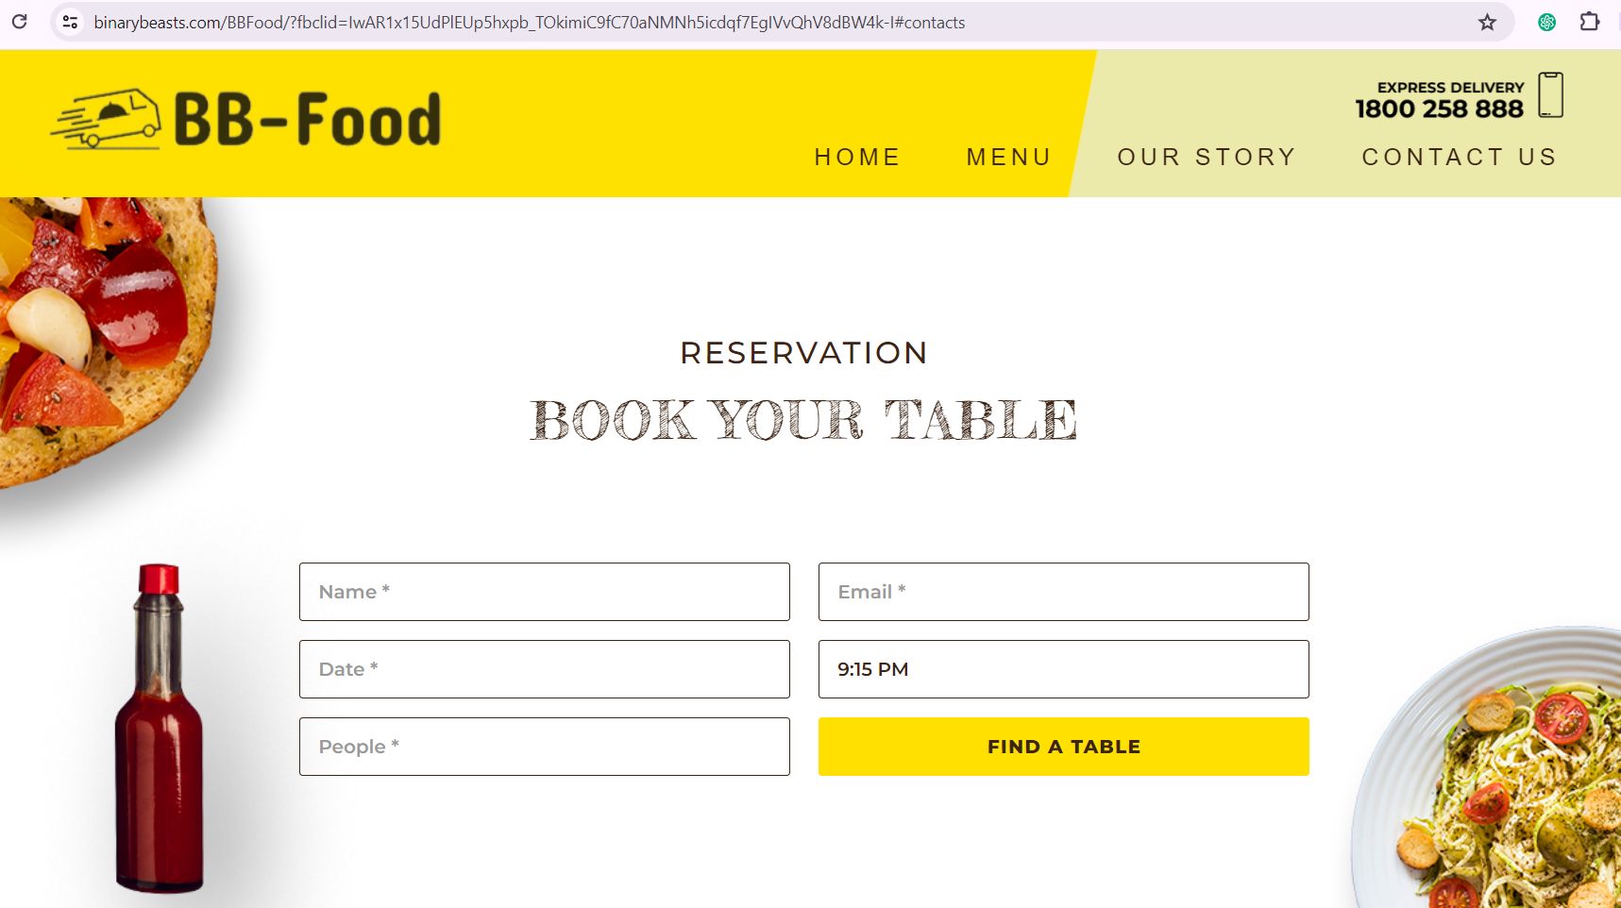
RESERVATION FORM
BB-FOOD

Slide 14
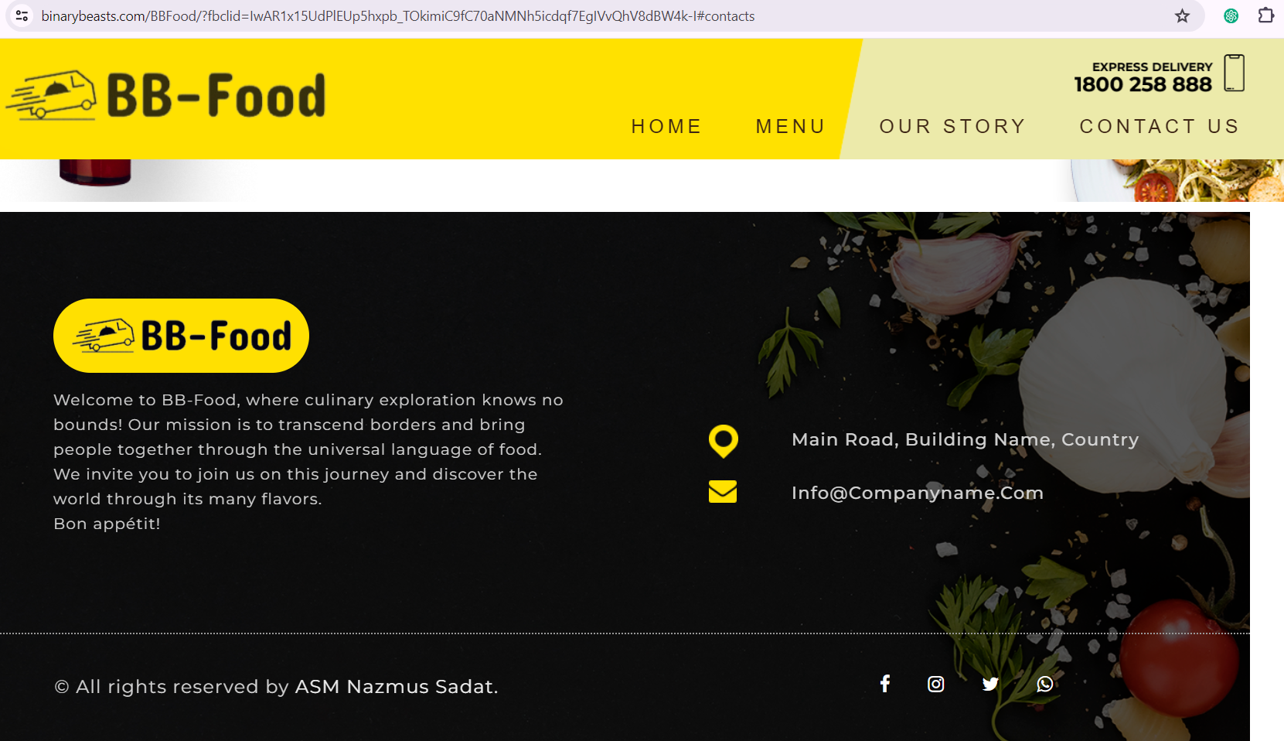
CONTACT
BB-FOOD

Slide 15
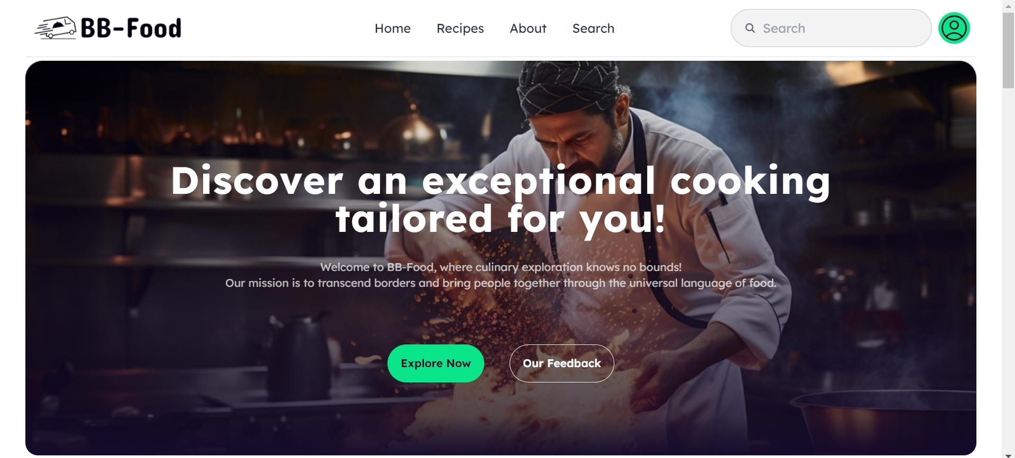
ORDER HOME PAGE
BB-FOOD

Slide 16
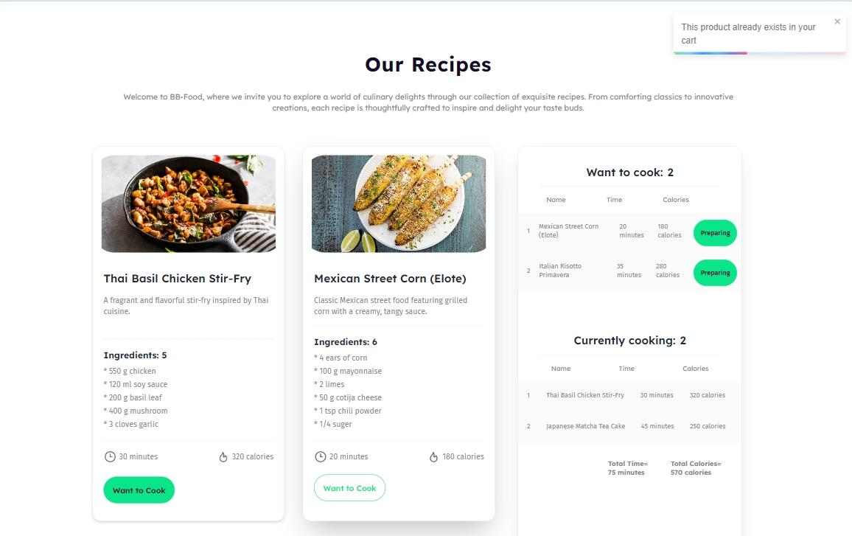
DETAILS & TIMING
BB-FOOD

Slide 17
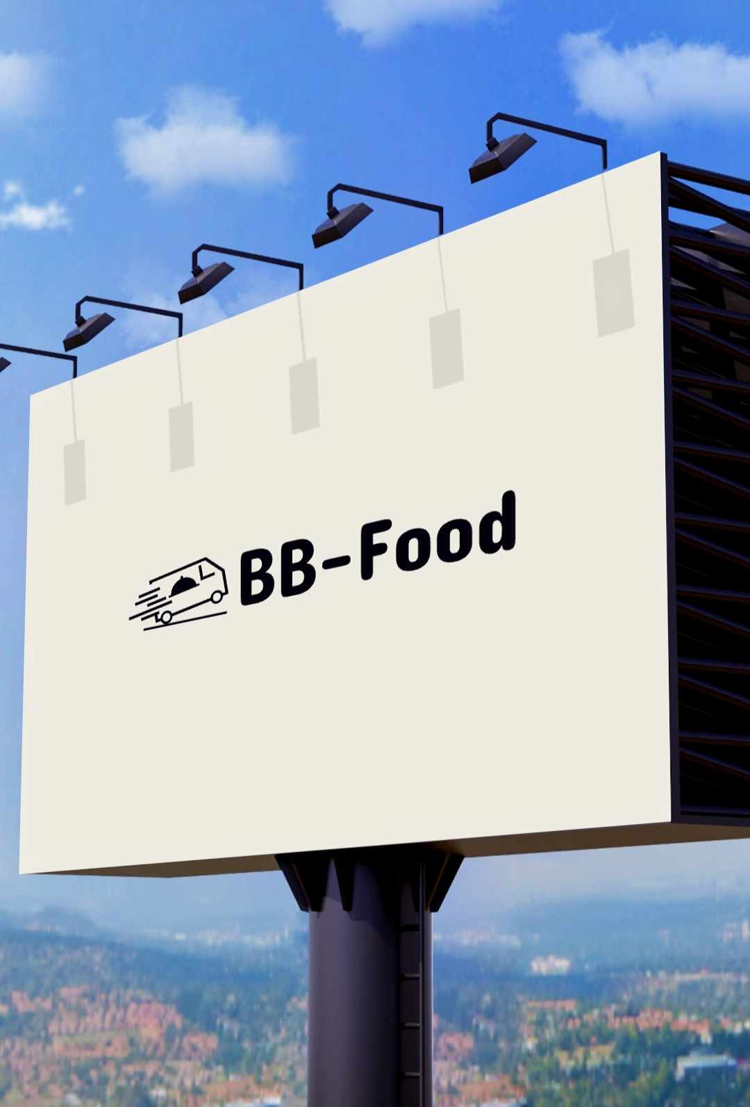
Summary:
In the delightful journey of creating ‘BB - Food,’
we’ve cooked up more than a simple e-commerce site. It's a flavorful blend of user-friendly design and tech resilience. Challenges were like spices, adding depth to its characters.
In conclusion, 'BB-Food' is our promise to spice up digital food shopping, always evolving to satisfy the ever-changing tastes of users. It's not just a platform; it's a celebration of the delicious journey we're on together.

Slide 18
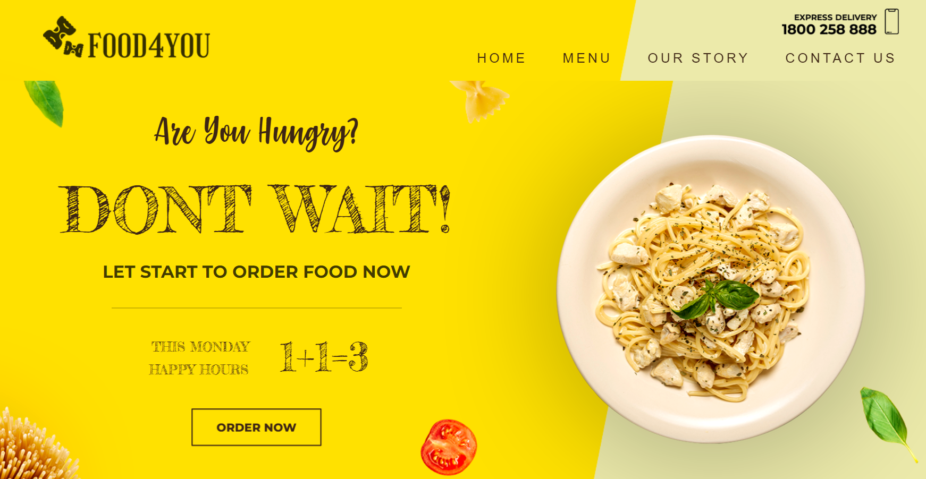
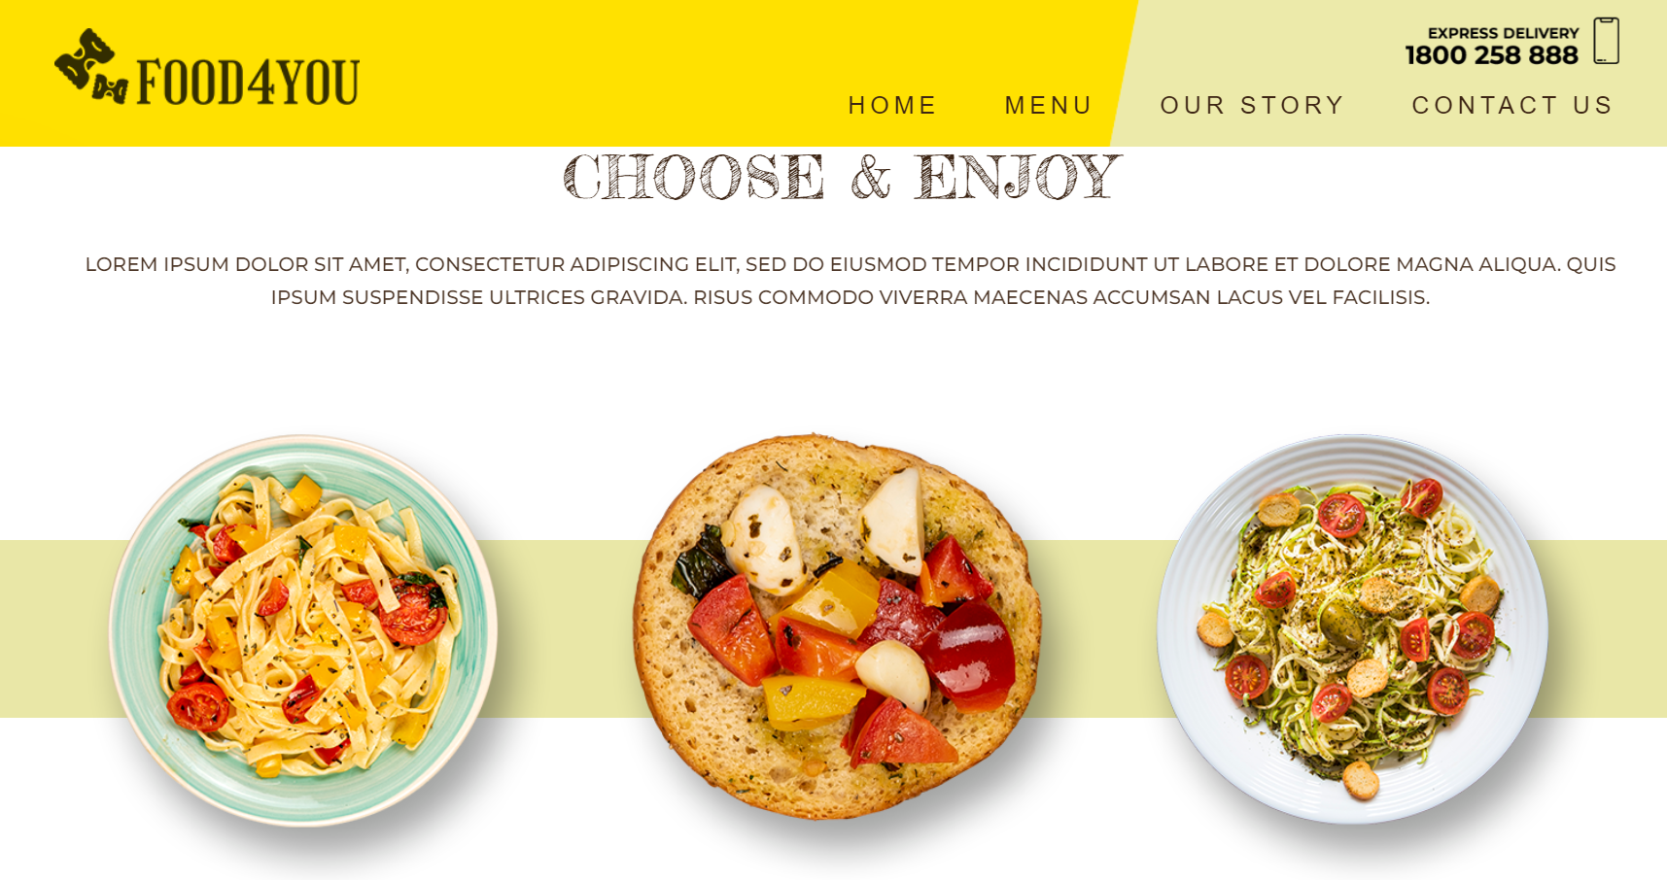

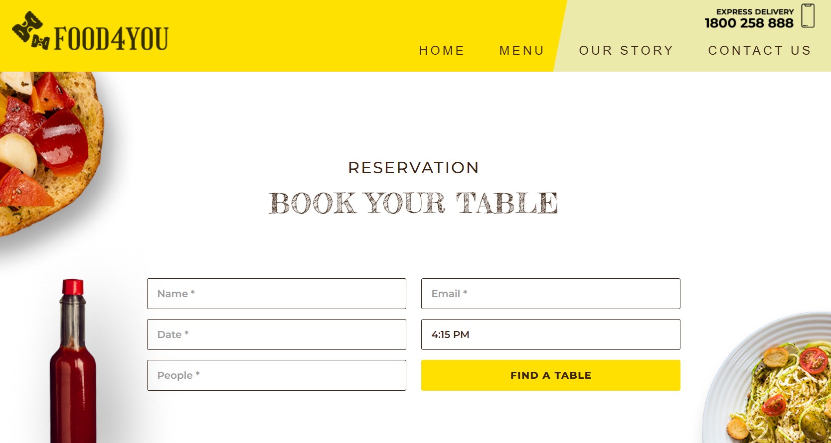
Thank you
Our Android apk link:
https://github.com/SadatRiyad/FOOD4YOU_Full-Responsive-1Page-Website
https://binarybeasts.com/BBFood/
https://binarybeasts.com/BBFood/BB-Food.apk

